Slide 1
Problem Identification
Big Mountain Resort Data Presentation

Slide 2
Big Mountain Resort Problem Statement
Develop a data-driven methodology for setting best value prices for the access to and related services at ski trails and snowboard areas at Big Mountain Resort, based on specific comparable parameters at 330 US resorts and factoring in key metrics: resort’s landscape and climate, facility capacity and configuration, seasonal attendance to availability ratio, and price sensitivity by skill level groups.
Context
Big Mountain Resort (BMR), a Montana based ski resort is struggling to validate their pricing strategy which is to simply add an arbitrary premium above average market. Such approach is likely to overlook specific advantages their facilities might have over those at competing resorts. BMR management feels that after pouring large investments into their facilities, they aren’t fully capitalizing on them. BMR wants to implement data driven method for setting ticket prices, which would leverage their advantages in both the facility infrastructure and skiing landscape, as well as for reallocating costs to optimize returns on investment.
Criteria for success
BMR will run a comparative analysis of data on 330 US resorts to determine ski facility metrics: capacities, specific configurations, utilization, and popularity. BMR will use the findings to implement a data driven business strategy in terms of committing resources and setting prices per specific trail locations and rider skill levels to yield and maintain increased profit margins - before this season starts.
Scope of solution space
BMR Data Scientist will use data on 330 US resorts to identify key metrics: landscape specific (elevation, vertical drop, area, climate), facility specific (equipment, capacity, years in operation), and operations (attendance, availability and utilization rates).
Scope of solution space
BMR will then determine how the metrics corelate and what specific factors drive revenues (pricing differences among the resorts, premium dynamics between weekday and weekends). Finally, BMR will adjust their cost allocations and pricing structure, according to the specified metrics, instead of using market average.
Constraints within solution space
Access to key stakeholders is limited only to the Director of Operations. While interaction with Operations is useful in assessing technical parameters of equipment, capacity and utilization rates, it may not be sufficient in drawing conclusions on what drives seasonal throughput of attendees – as it may be more than just facility configurations or the landscape. Direct discussions may need to be organized with other key stakeholders, especially those, authorized to make strategic decisions of significant financial impact on behalf of company. Limited availability of data – it is not clear what type of BMR’s own data is available for analysis. In addition to comparing key metrics to those presented in the dataset on 330 US resorts, the internal data may shed light on what resort services and products are in higher demand than others and thus, less elastic to price increases – such nuances are specific to BMR, testable, backed

Slide 3
Big Mountain Resort Problem Statement
Develop a data-driven methodology for setting best value prices for the access to and related services at ski trails and snowboard areas at Big Mountain Resort, based on specific comparable parameters at 330 US resorts and factoring in key metrics: resort’s landscape and climate, facility capacity and configuration, seasonal attendance to availability ratio, and price sensitivity by skill level groups.
Constraints within solution space
by actual historical data and thus, are more reliable than hypotheses, deriving from observing other resorts’ data
Stakeholders to provide key insight
Key stakeholders and Subject Matter collaborators include: Jimmy Blackburn – Director of Operations (subject matter expert, and likely, one of decision makers) Alesha Eisen – Database Manager (support, data source)
Key data sources
Data sources: CSV file – as provided by Alesha Eisen Additional data – as necessary: Jimmy Blackburn – historical operations data Key Data requirements: Landscape parameters – to categorize US resorts into a framework of comparable references on run distances, vertical drops, snowfall volumes, season durations, etc., so that BMR may be accurately positioned, when assessing advantages
Key data sources
Historical operating logs – to plot available capacity to attendance ratio by season, weekday vs. weekend, age and skill level groups, to draw conclusions on factors driving popularity of resort, as well as those limiting it. Depending on availability of additional internal data – analyse the patterns of how chairs are occupied among 4-seat, 6-seat, 8-seat chairs, as well as occupancy rates in the magic carpets and trams, to gain a deeper insight on attendees’ visiting and service use patterns, and ultimately – sensitivity to price increases Historical and forecasted infrastructure costs – work with the Director of Operations to understand the rationale for committing resources to capital projects and maintenance schedules, and to investigate whether some fixed operating expenses may be better distributed by reallocating committed resources from underutilized assets to those in higher use.

Slide 4
Recommendation and Key Findings
Big Mountain Resort Data Presentation

Slide 5
Key Findings and Recommendations
Key Findings
The key findings, which were determined upon analyzing the data and running models, are as follows: pricing strategy should be based on comparable parameters across all 330 ski resorts in the U.S., irrespective of a given resort’s state there is a strong correlation between the ticket price and the following resort features: vertical drop, fast quads, runs, and snow coverage closing down up to 5 least used runs at BMR resort has a small impact on the ticket price support
Recommendations
Based on the presented Key Findings, it is recommended that BMR management considers the following: closing down from 3 to 5 of its least used runs to lower total operating costs and increasing profit margins adding a 150 feet drop, installing a new chair to serve the additional drop, and raising the price by up to $8.61/ticket

Slide 6
Modeling Results and Analysis
Big Mountain Resort Data Presentation

Slide 7
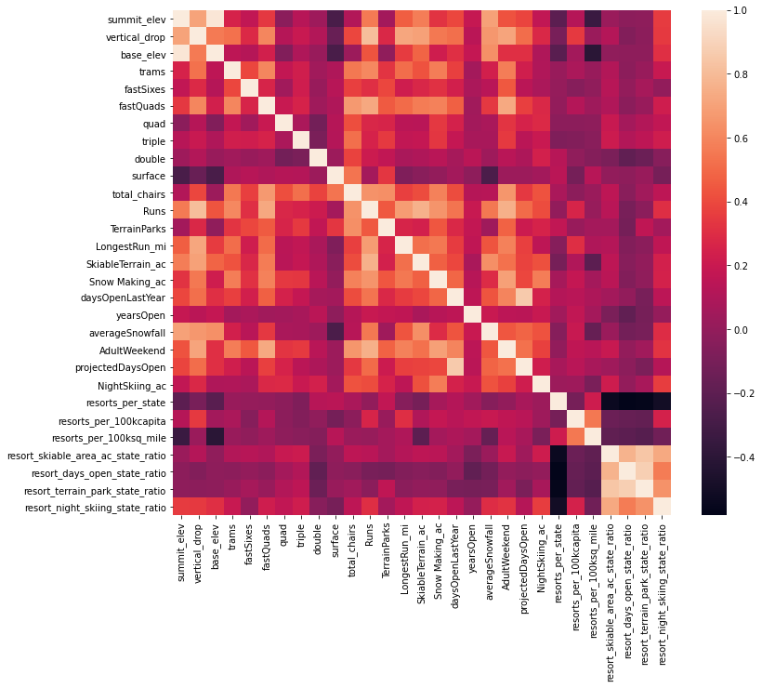
Modeling Results and Analysis
Exploratory Data Analysis
During the exploratory data analysis, it becomes clear that there is no relationship between states and ticket prices. The analysis showed strong correlation of adult ticket prices with the following data features across resorts: vertical drop fastQuads Runs Snow Making_ac The heatmap and a series of scatter plots further confirmed this pattern.
Heatmap of features

Slide 8
Modeling Results and Analysis
Linear Regression Model
The Linear Model further supported the patterns, initially found during the exploration. The linear regression model found that there is a strong correlation between the ticket price and the following resort features: vertical_drop Snow Making_ac total_chairs fastQuads
Liner Regression Model Results
The Linear Model Features: vertical_drop 10.767857 Snow Making_ac 6.290074 total_chairs 5.794156 fastQuads 5.745626 Runs 5.370555 LongestRun_mi 0.181814 Trams -4.142024 SkiableTerrain_ac -5.249780 The Linear Model performance: Cross-validation Mean Absolute Error: 10.499032338015294 Variability: 1.6220608976799664 Mean Absolute Error: 11.793465668669324

Slide 9
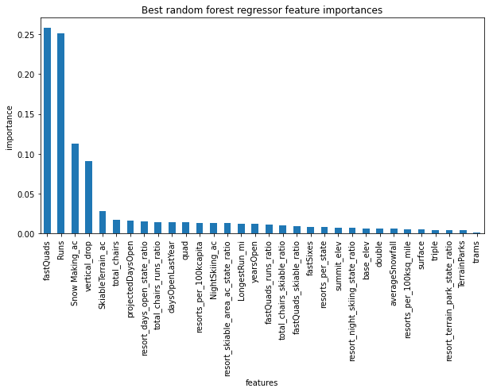
Modeling Results and Analysis
Random Forest Model
The Random Forest Model also returned top four features that were common with the Linear Model: fastQuads Runs Snow Making_ac vertical_drop
The Random Forest Model performance
Cross-validation Mean Absolute Error: 10.499032338015294 Variability: 1.6220608976799664 Mean Absolute Error: 11.793465668669324
Random Forest Model Results

Slide 10
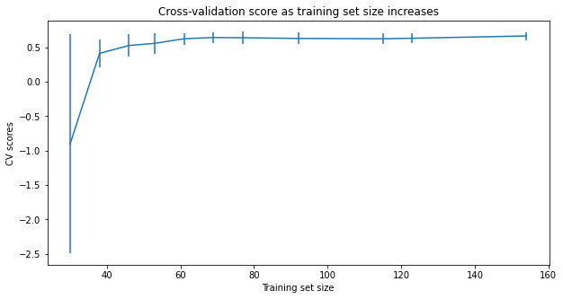
Modeling Results and Analysis
Analysis
After comparing the cross-validation MAE values for the two models, we concluded that the random forest model was a better choice, because it showed lower CV MAE and less variability. The performance on the test set was also consistent with the cross-validation results.
Data quantity assessment
Finally, we assessed whether the model would benefit from additional data collection by running the sklearn’s learning_curve function.
The CV score and Training set size plot showed that no further data collection would be required. As the plot shows, the improvement in the model scores starts flatting out by around a sample size of 40-50

Slide 11
Summary and Conclusion
Big Mountain Resort Data Presentation

Slide 12
Summary and Conclusion
Summary
We ran the random forest model for the 4 scenarios: Scenario 1: closing down 2-3 runs reduces support for ticket pricing by $0.50. Closing of another 1-2 runs, i.e., total of 4-5 runs, does not result in further reduction in the price support; however, closing down 6 or more runs leads to significant drops in price support. Scenario 2: adding 150 feet drop increases the price support by $8.61 and leads to $15,065,471 in additional revenue projection; however, the additional Opex of $1,540,000 will need to be factored in in to determine the assumed profit margin. Scenario 3: adding 150 feet drop AND adding the snow making area increases support for ticket price by $9.90 and leads to $17,322,717 in additional revenue projection; however, on top of adding $1,540,000 for the new chair, we will need also factor in the additional operating costs due to increased snow making capacity, to determine the assumed profit margin.
Summary
Scenario 4: increasing the longest run by 0.2 miles and adding 4 acres of snow making capability does not move the needle at all – it is obvious the random forest regression model ranked this feature as not important. Plus, the increased operating cost related to adding more snow making capacity will erode the profit margins.
Conclusion
We would recommend that BMR management considers Scenario 2 as the optimal strategy, because for the additional revenue increase of $15,065,471 or $8.60/ticket, BMR would net $13,525,471 in gross profit margins, or $7.72/ticket – after factoring in the increased Opex of $1,540,000 or $0.88/ticket. Finally, we would also recommend BMR to close down up to 5 the least used runs – which may result in lowering the ticket prices by $0.50/ticket, but would also greatly reduce the operating expenses, so the overall gross profit margins would go up even further. We would recommend that BMR starts with closing down the first 3 runs to test the theoretical assumptions and then proceed with closing down the 4th and 5th runs accordingly.

